Slide 1
Teoria dos Jogos em Computação
Pedro O.S. Vaz de Melo
1/2025

Slide 2
Agenda
What is game theory?
Computer Science applications
Course program
Grading
References
Goals

Slide 3
Agenda
What is game theory?
Computer Science applications
Course program
Grading
References
Goals

Slide 4

Before we start...
This course is not about...

Slide 5
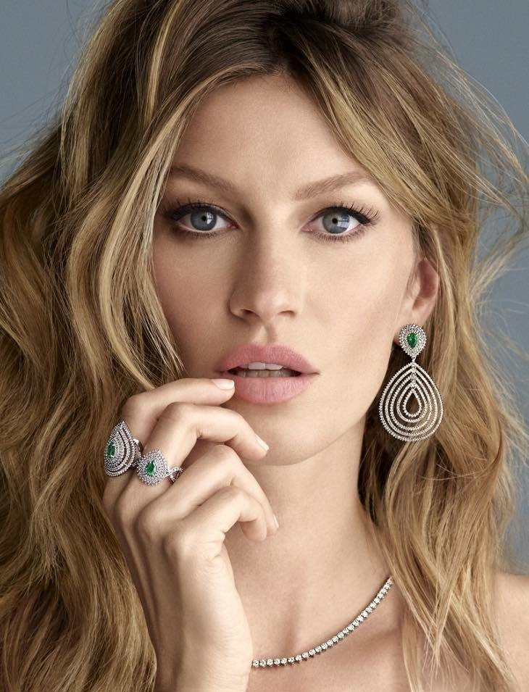
Before we start...
This course is about modeling

Slide 6
Before we start...
This course is about modeling
Should a local competitor open a store next to a chain store?

Slide 7
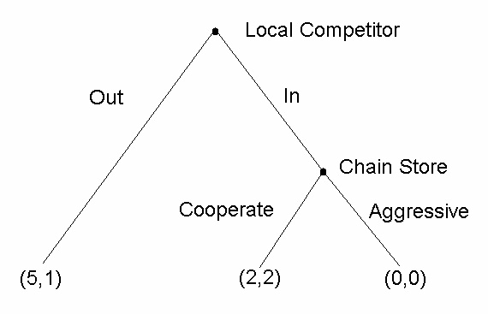
Before we start...
This course is about modeling

Slide 8
What is game theory?
Game theory studies settings where multiple players (agents) each have
different preferences (utility functions)
different actions that they can take

Slide 9
What is game theory?
Let's play a game…
Each student should write a number between 0 and 100 on a paper
The student who gets closer to the average wins

Slide 10
What is game theory?
Let's play another game…
Each student should write a number between 0 and 100 on a paper
The student who gets closer to half the average wins

Slide 11
What is game theory?
Let's play another game…
Each student should write a number between 0 and 100 on a paper.
The student who gets closer to half the average wins
What is the solution of this game?

Slide 12
What is game theory?
Let's play a final game…
Each student should write a number between 0 and 100 on a paper
Two winners
The student who gets closer to half the average
The student who gets closer to the amplitude (biggest difference)

Slide 13
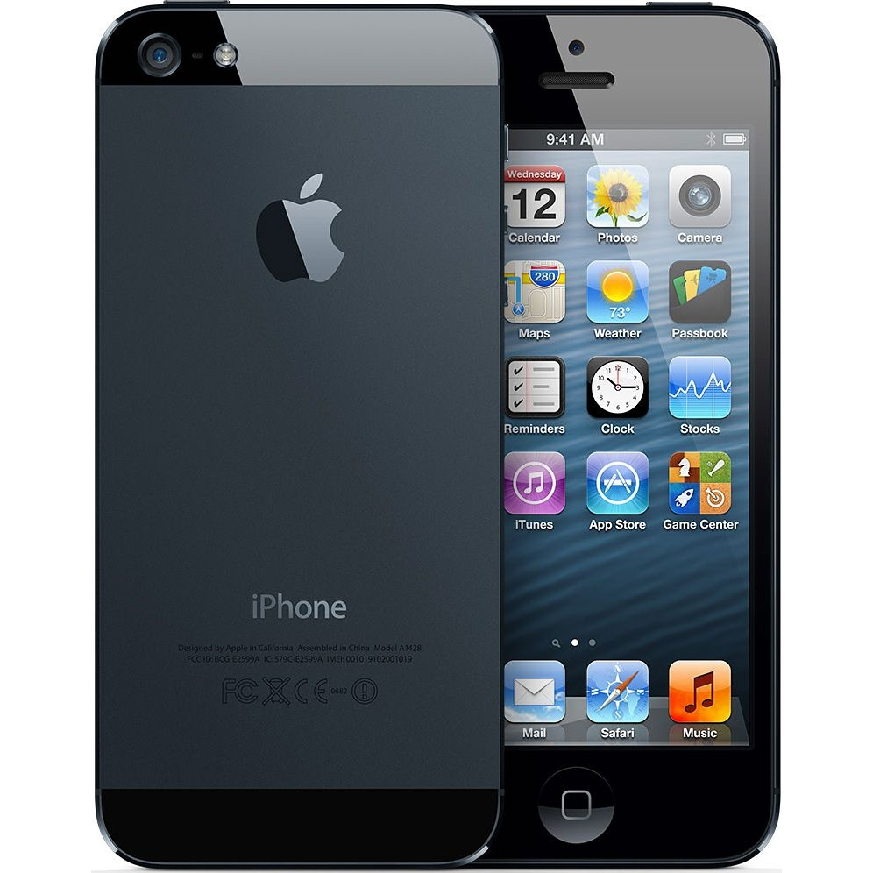

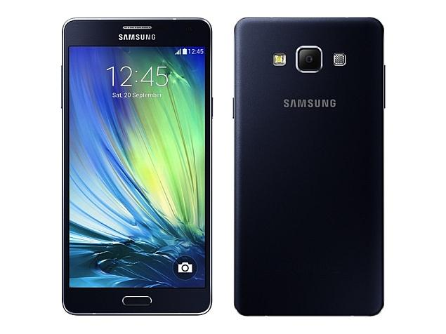



What is game theory?
Three kids must choose a cell phone

Slide 14
What is game theory?
Who are the players?

Slide 15
What is game theory?
What are their strategies?

Slide 16
What is game theory?
What are the possible outcomes?

Slide 17
What is game theory?
The action of an agent can influence the strategy of another?

Slide 18
What is game theory?
What are the possible payoffs for each agent?

Slide 19
What is game theory?
Each agent’s utility (potentially) depends on all agents’ actions
What is optimal for one agent depends on what other agents do

Slide 20
What is game theory?
Each agent’s utility (potentially) depends on all agents’ actions
What is optimal for one agent depends on what other agents do
Very circular!
I won't buy what
Butters buys!
I will buy what
Cartman buys!

Slide 21
What is game theory?
Game theory studies how agents can rationally form beliefs over what other agents will do, and (hence) how agents should act

Slide 22
What is game theory?
Game theory studies how agents can rationally form beliefs over what other agents will do, and (hence) how agents should act
Useful for acting as well as predicting behavior of others
Cartman is a show-off!
If I use my college funds,
I can buy an iPhone!
Butters don't have money
to buy an iPhone!
That's the one I'll get it!

Slide 23
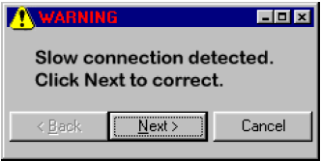
What is game theory?
TCP Backoff game

Slide 24
What is game theory?
TCP Backoff game
Question: Should you send your packets using correctly-implemented TCP (which has a “backoff” mechanism) or using a defective implementation (which doesn’t)?

Slide 25
What is game theory?
TCP Backoff game
This problem is an example of what we call a two-player game:
both use a correct implementation: both get 1 ms delay
one correct, one defective: 4 ms for correct, 0 ms for defective
both defective: both get a 3 ms delay.

Slide 26
What is game theory?
TCP Backoff game
What action should a player of the game take?
Would all users behave the same in this scenario?
What global behavior patterns should a system designer expect?
For what changes to the numbers would behavior be the same?
What effect would communication have?
Repetitions? (finite? infinite?)
Does it matter if I believe that my opponent is rational?

Slide 27
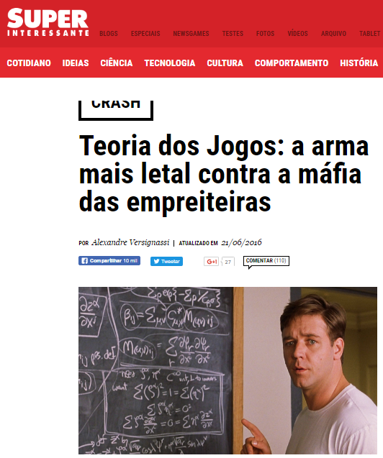
On the media

Slide 28
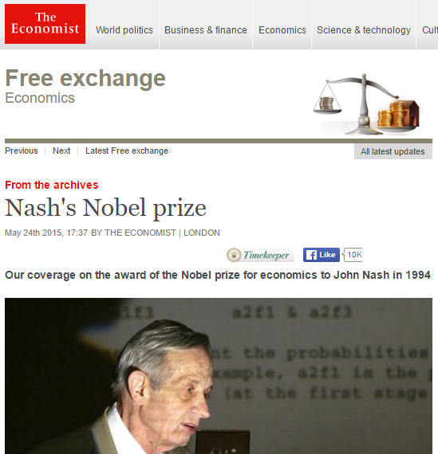
On the media

Slide 29
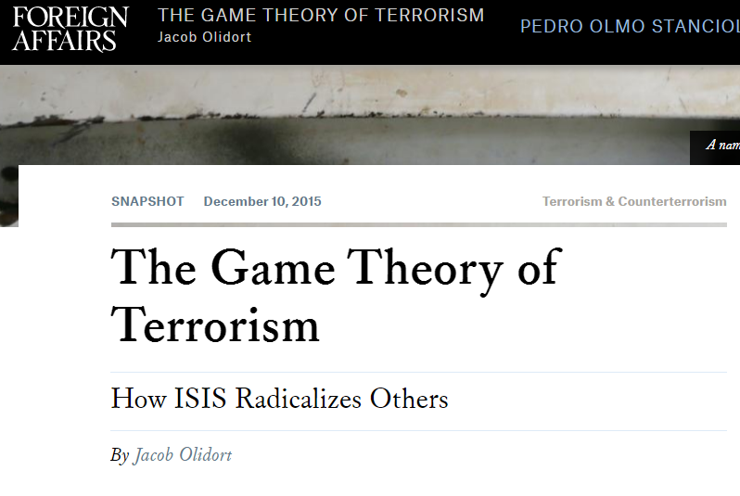
On the media

Slide 30
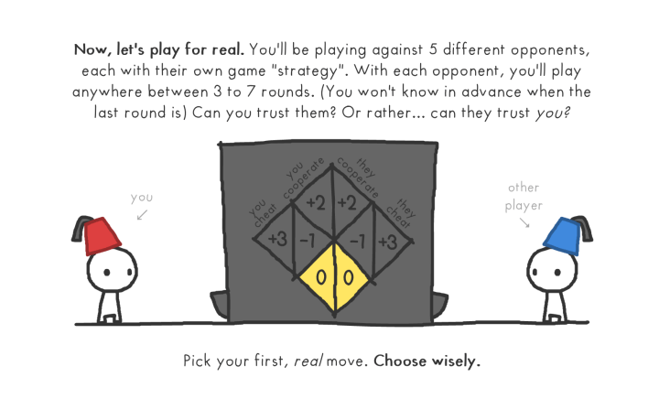
On the media
The evolution of trust
http://ncase.me/trust/

Slide 31
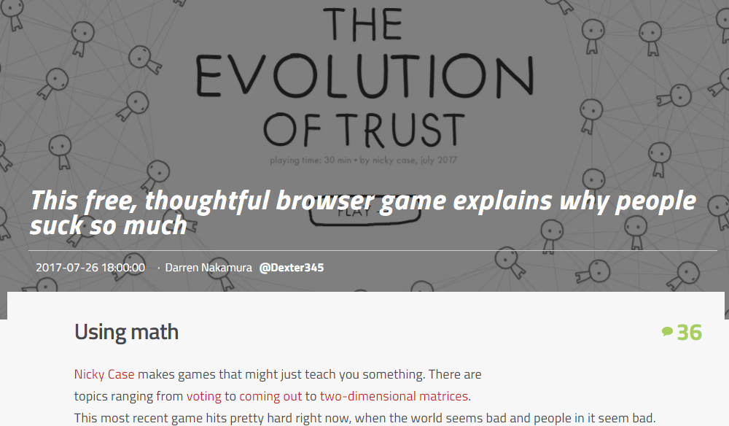
On the media

Slide 32
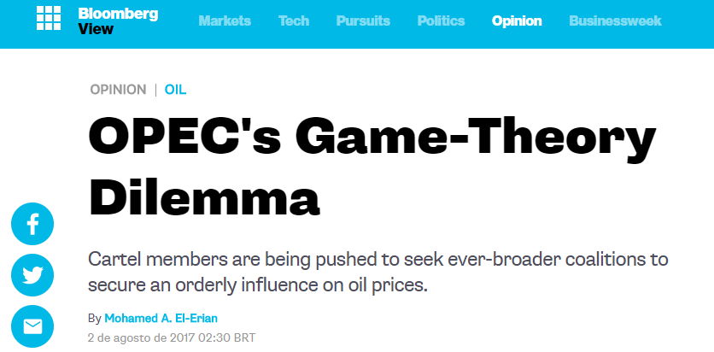
On the media

Slide 33
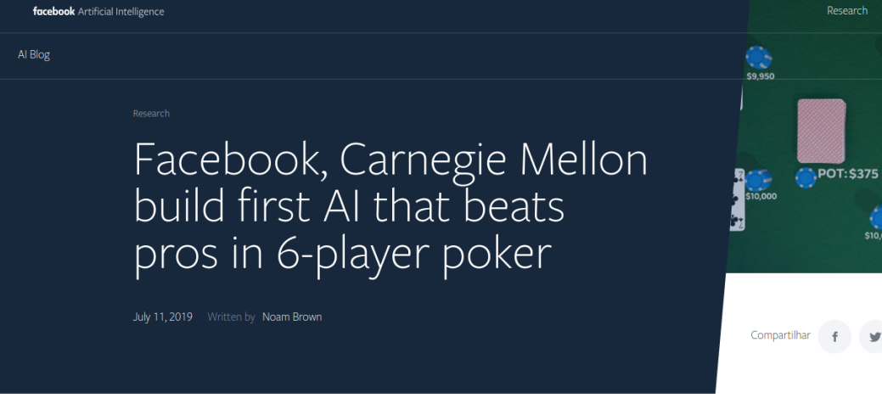
On the media
https://www.technologyreview.com/lists/innovators-under-35/2017/inventor/ian-goodfellow/

Slide 34
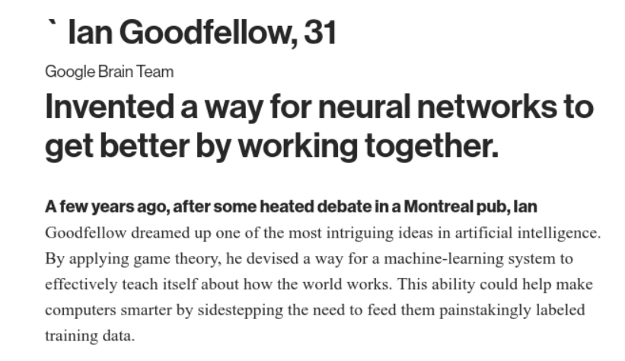
On the media
https://ai.facebook.com/blog/pluribus-first-ai-to-beat-pros-in-6-player-poker/?refid=52&__tn__=HH-R

Slide 35
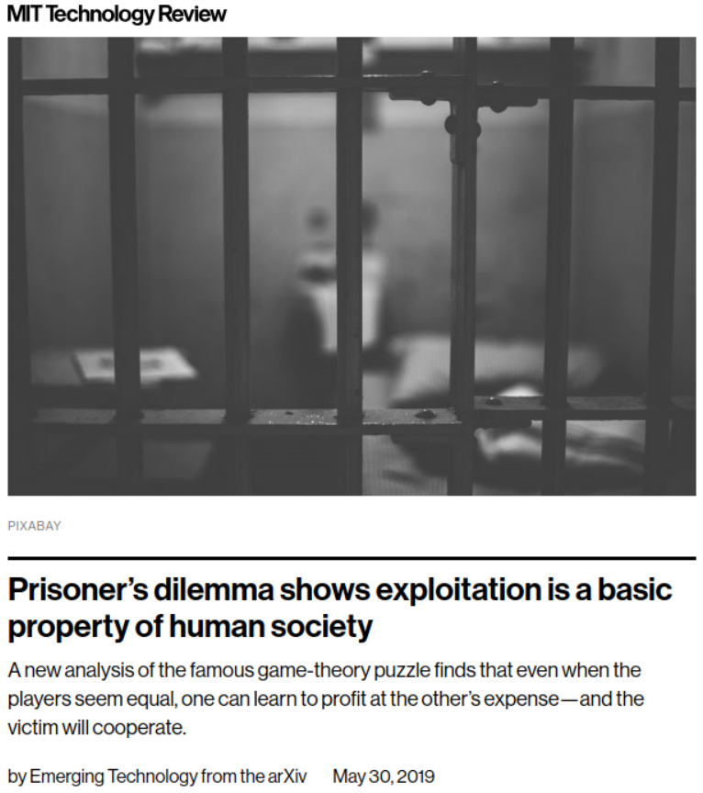
On the media
https://www.technologyreview.com/s/613585/prisoners-dilemma-shows-how-exploitation-is-a-basic-property-of-human-society/amp/?__twitter_impression=true

Slide 36
Agenda
What is game theory?
Computer Science applications
Course program
Grading
References
Goals

Slide 37
Where is game theory used?
Economics (& business)
Auctions, exchanges, price/quantity setting by firms, bargaining, funding public goods, …
Political science
Voting, candidate positioning, …
Biology
Stable proportions of species, sexes, behaviors, …
Philosophy
Conventions, ethics, …

Slide 38
And in Computer Science?
Artificial Intelligence
Beat the Cheater: Computing Game-Theoretic Strategies for When to Kick a Gambler out of a Casino, AAAI'14
Towards a game theoretic approach for defending against crime diffusion, AAMAS'14
On influence, stable behavior, and the most influential individuals in networks: A game-theoretic approach, Elsevier Artificial Intelligence, 2014

Slide 39
And in Computer Science?
Computer Networks
Game-Theoretic Topology Control for Opportunistic Localization in Sparse Underwater Sensor Networks, IEEE Trans. On Mobile Comp., 2014
Selfish behavior and stability of the internet:: a game-theoretic analysis of TCP, Sigcomm'02
Topology Design of Communication Networks: A Game-Theoretic Perspective, IEEE/ACM Trans. On Networking

Slide 40
And in Computer Science?
Security
Game-Theoretic Analysis of DDoS Attacks Against Bitcoin Mining Pools, Financial Cryptography and Data Security, 2014
A Cryptographic Solution to a Game Theoretic Problem, Advances in Cryptology, 2014
RRE: A Game-Theoretic Intrusion Response and Recovery Engine, IEEE Transactions on Parallel and Distributed Systems, 2013

Slide 41
And in Computer Science?
Complex networks and Web
Centrality and power in social networks: a game theoretic approach, Mathematical Social Sciences, 2003
Price Competition in Online Combinatorial Markets, WWW'14
Modeling collaboration in academia: a game theoretic approach, WWW'14 Companion

Slide 42
And in Computer Science?
Data Mining and Big Data
Large human communication networks: patterns and a utility-driven generator, KDD'09
A Game Theoretic Framework for Analyzing Re-Identification Risk, Plos One, 2015
Game-Theoretic Strategy Analysis for Data Reliability Management in Cloud Storage Systems, Software Security and Reliability (SEME'14)

Slide 43
And in Computer Science?
Robotics
Game theoretic controller synthesis for multi-robot motion planning Part I: Trajectory based algorithms, IEEE International Conference on Robotics and Automation (ICRA'14)
Computer Vision
A Game-Theoretic Probabilistic Approach for Detecting Conversational Groups, ACCV'14

Slide 44
And in Computer Science?
Information Retrieval
Towards a Game-Theoretic Framework for Information Retrieval, SIGIR'15
Distributed Computing
Distributed computing meets game theory: robust mechanisms for rational secret sharing and multiparty computation, PODC '06
Machine Learning
Goodfellow, Ian, et al. "Generative adversarial nets." Advances in neural information processing systems. 2014.

Slide 45
Agenda
What is game theory?
Computer Science applications
Course program
Grading
References
Goals

Slide 46

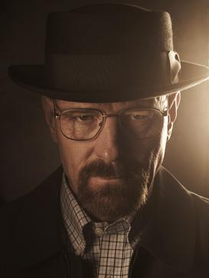
Rationality

Slide 47
Decision and Utility Theory

Slide 48
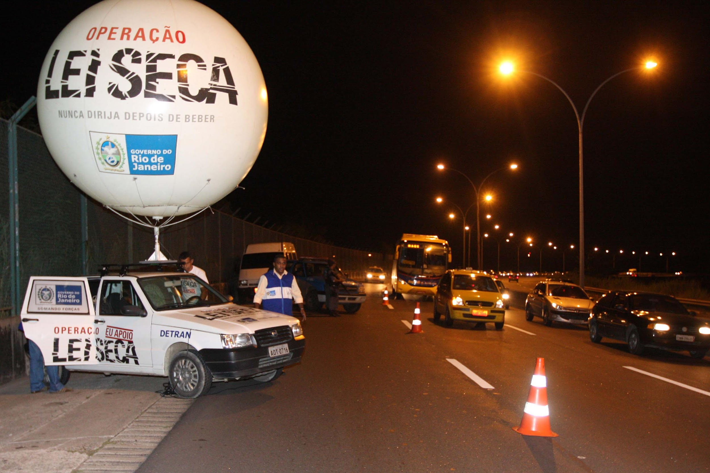
Games

Slide 49

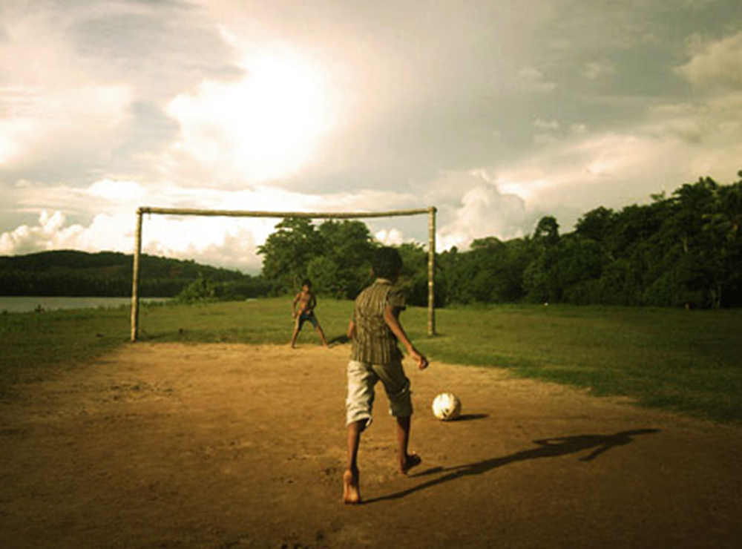
Types of games
Zero-sum games
coordination games

Slide 50
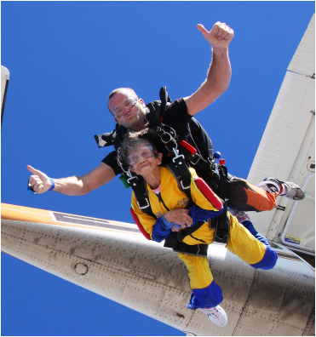
Game Solutions
Should Grace celebrate her 91st birthday by jumping out of a plane strapped to this guy?

Slide 51
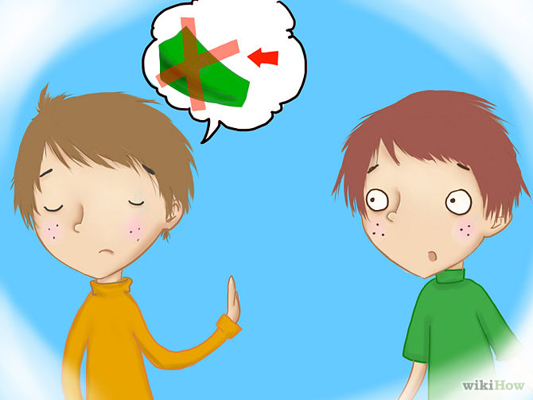
Repeated games
Should Al lend some money to Bob?

Slide 52
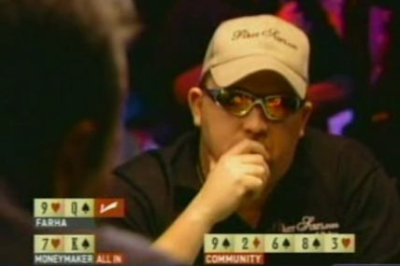
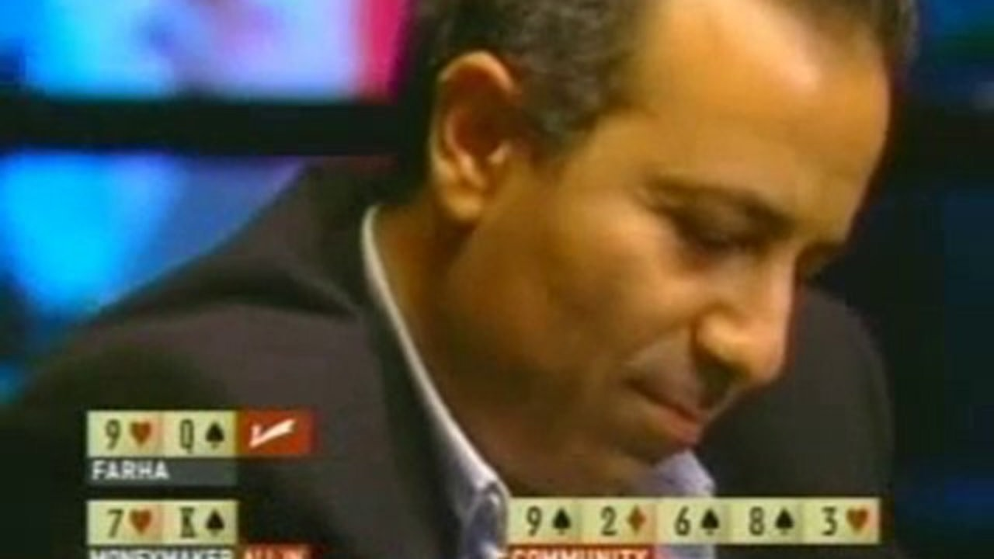
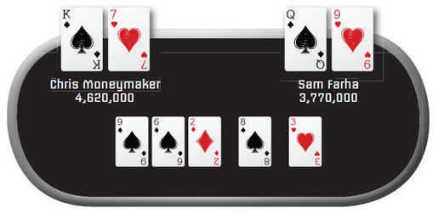
Bayesian and imperfect
information games

Slide 53
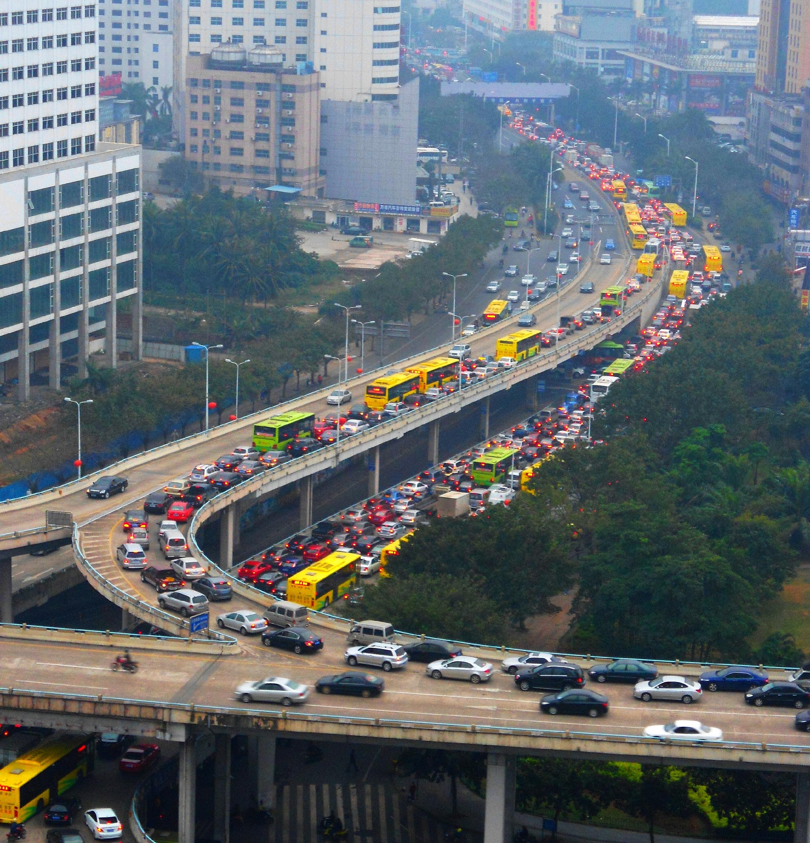
Congestion games

Slide 54
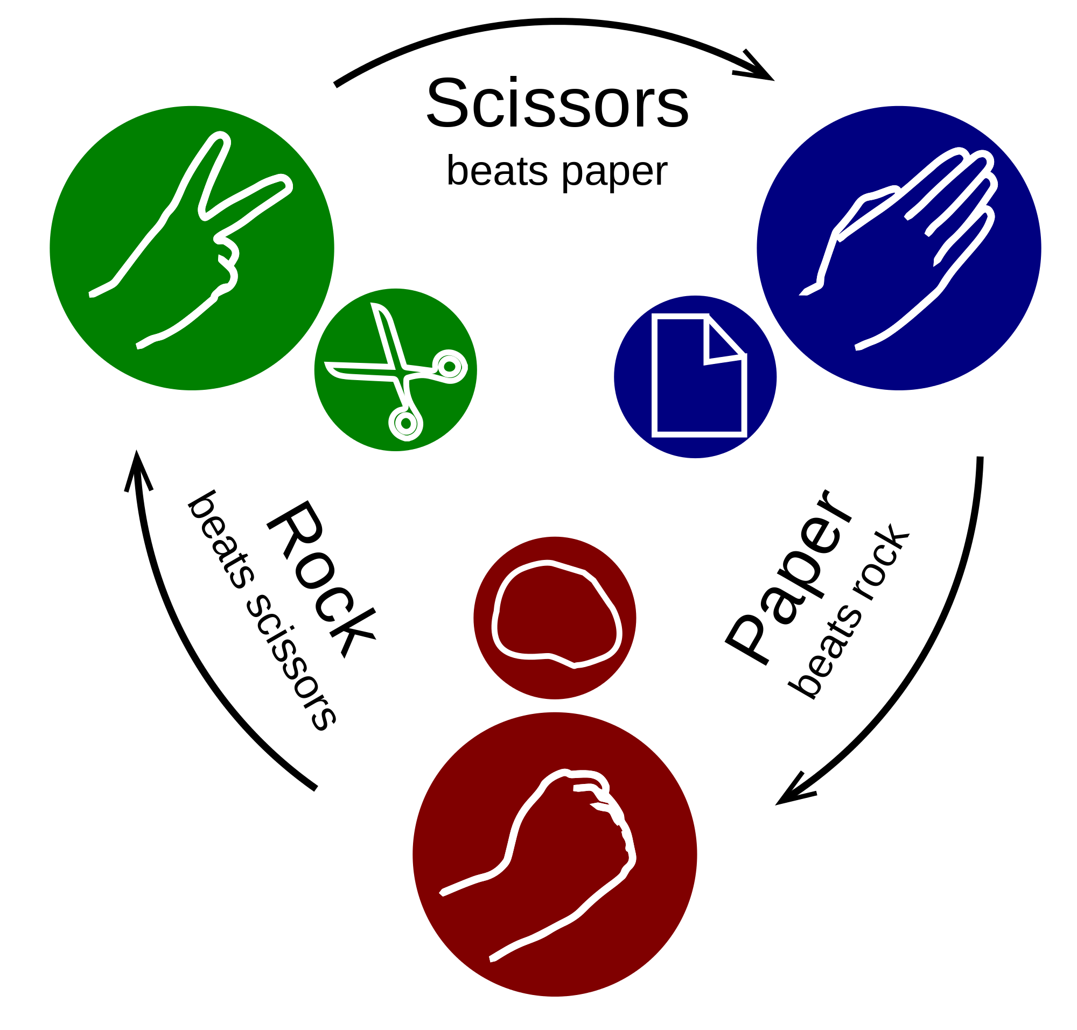
Learning and Teaching in games
Can I design an algorithm to perform better than random in PRS?

Slide 55
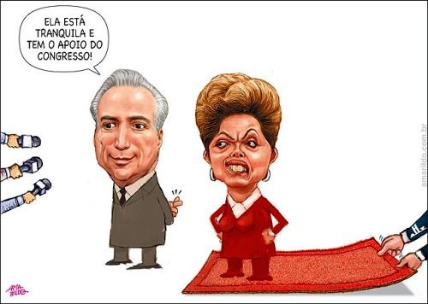
Coalitional games

Slide 56
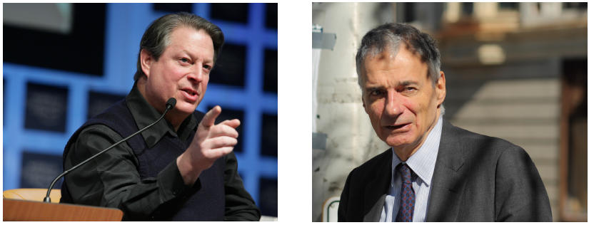
Social Choice
In 2000, the US presidential election came down to Florida. George Bush won by 537 votes. But Ralph Nader got 97,421 votes. Twice as many Nader voters would have chosen Gore over Bush

Slide 57

Mechanism Design
Businesses on both sides of a river need to decide whether to build a bridge, and if so how to pay for it

Slide 58
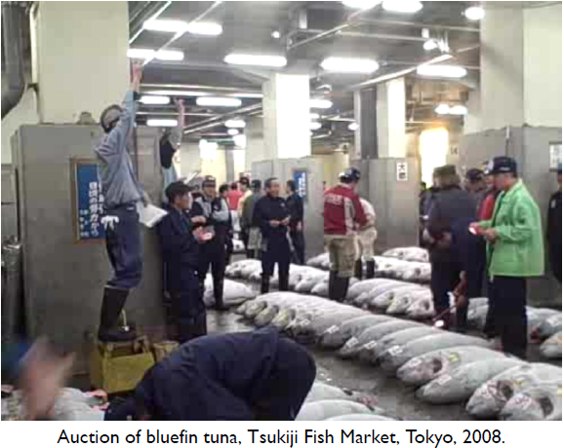
Auctions

Slide 59

Game Theory in Computer Science
Seminars

Slide 60
Course program
Prerequisites
English
Discrete math
Basic set theory
Basic probability theory
Notions of algorithms

Slide 61
Agenda
What is game theory?
Computer Science applications
Course program
Grading
References
Goals

Slide 62
Grading
2 Exams
Class project
3 Exercise lists
Participation
Seminar
PD competition

Slide 63
Exams
Mostly modeling questions
Given a situation, how game theory can be used to model it?
Simple and easy questions
Don't require advanced math (e.g. calculus) to solve
May require knowledge about every topic given in class, which are covered by the books as well

Slide 64
Class project (20)
An attempt to do some original work on topics related to the course
Alone or with colleagues (depends on the number of enrolled in the course)
Theoretical or experimental
Creativity is encouraged
The final product is a writeup (in the form of a research paper)
Some projects may lead to publishable papers

Slide 65
Class project (20)
Consider your own research and its relationship to the course
Do you work on techniques that can be applied to any of the course's problems?
Can techniques in the course help your work?
Take some result in the course that you like, and change the setting
Do things become easier (harder) if we look at a more restricted (more general) version of the problem?
Do analogous results hold in similar settings?

Slide 66
Class project (20)
On its simplest form:
Find a non trivial scenario
Describe this scenario informally: players, actions, conflicts, utilities, complications
Model one or more configurations for this scenario formally
game type
players
strategies
payoffs
solutions
Discussion and conclusions

Slide 67
Class project (20)
Algorithmic game theory:
Pick a type of game
Implement one or more algorithms to find solutions in that type of game
Evaluate how these algorithms perform when the game grows
(optional) Change the algorithms for any given (positive) purpose
(optional) Evaluate such change

Slide 68
Seminar (20)
Alternative class project
Find an interesting research paper that (uses / deals with) game theory
Look for papers published in top venus:
https://scholar.google.com.br/citations?view_op=top_venues&hl=en&vq=eng_gametheorydecisionscience
Alternatively, find a topic that was not cover in class
Make a didactic presentation, explaining the paper or the topic in details
Expected length of the presentation: 20 minutes

Slide 69
Participation (10)
Points are given on my best judgement (sorry!)
Lower bounded by:
I will ask for students to participate in several activities during classes
Games, quizzes, exercises
You will get points by your participation and performance in those activities

Slide 70
Games
Students will be called randomly
Every time you do not participate, you lose 2 points
Every time you perform better than the baseline outcome, you gain 1 point
Every time you perform worse than the baseline outcome, you lose 1 point
For every game, I will show what is the baseline outcome

Slide 71
Grading
2 Exams (25 + 25)
1 Seminar or Class Project (20)
3 exercise lists (20)
Participation (10)

Slide 72
Agenda
What is game theory?
Computer Science applications
Course program
Grading
References
Goals

Slide 73
References
Slides
Books
Courses
Papers

Slide 74
Slides
I will post all the slides on Moodle
The slides may contain material different from the books

Slide 75
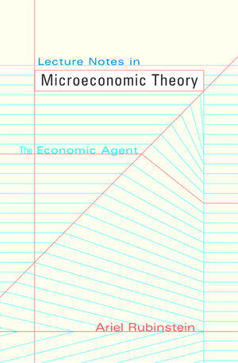
Books

Slide 76
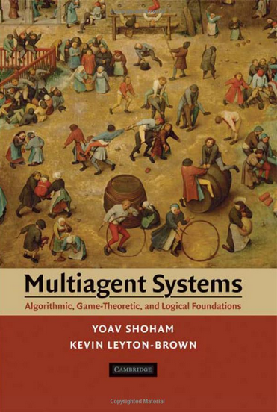
Books

Slide 77
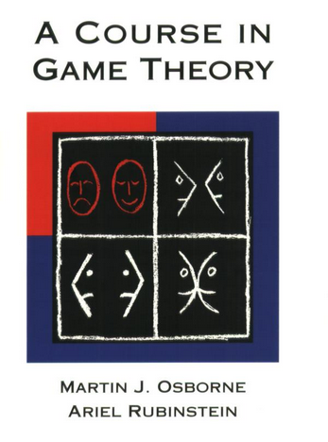
Books

Slide 78
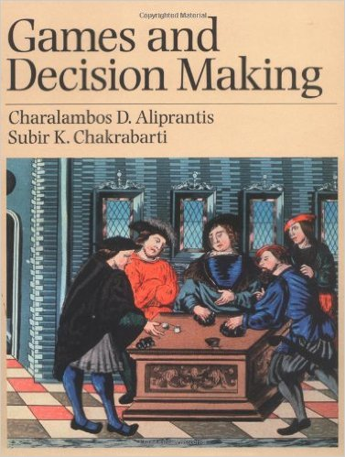
Books

Slide 79
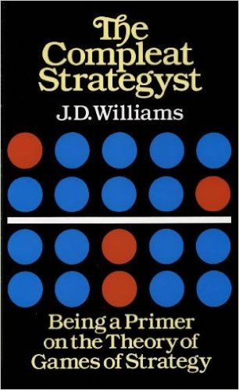
Books

Slide 80
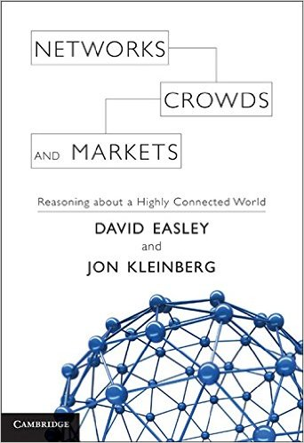
Books

Slide 81
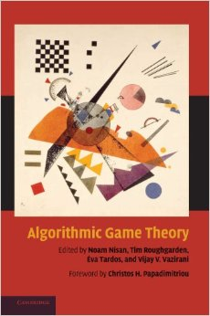
Books

Slide 82
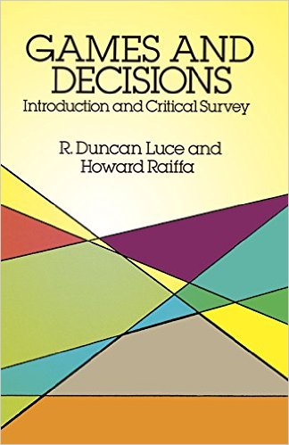
Books

Slide 83
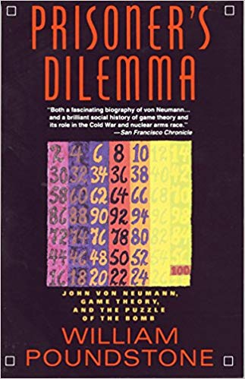
Books

Slide 84
Books
Good news!
All books (except the last two) are publicly available online

Slide 85
Courses
Coursera
Game Theory and Advanced Game Theory
M. Jackson, Y. Shoham, K. Leyton-Brown
Stanford University and UBC
Computational Game Theory and Mechanism Design
Vincent Conitzer, Duke
http://www.cs.duke.edu/courses/fall06/cps296.2/
Topics in Decision and Control: Static and Dynamic Game Theory
Bruce Hajek, University of Illinois
https://courses.engr.illinois.edu/ece586/sp2013/

Slide 86
Papers
I will recommend papers to be read together with the classes
I will also post a list of technical papers that link with computer science

Slide 87
Agenda
What is game theory?
Computer Science applications
Course program
Grading
References
Goals

Slide 88
Goals
Learn how to model conflict scenarios using game theory
Be able to read and understand computer science papers that use game theory as a framework
Be able to conduct your own research using game theory

Slide 89
Calendar
Show calendar

Slide 90
Task due to Sunday!
Details will arrive by e-mail
If you are enrolled to the course on Moodle

